Slide 1





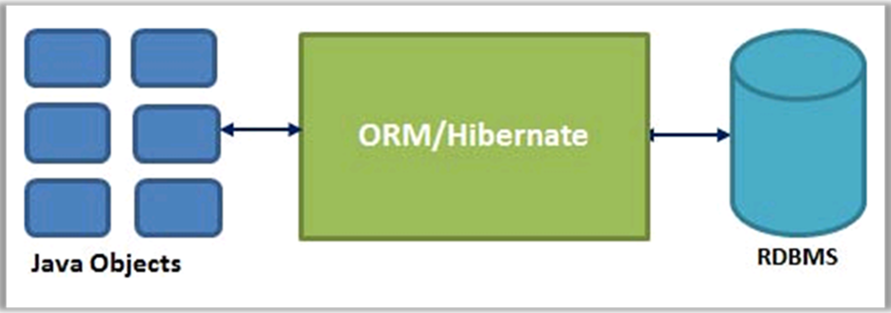
ORM in Java: Hibernate and JPA
SoftUni Team
Technical Trainers
Software University
http://softuni.bg

Slide 2


Table of Contents
ORM, Hibernate, JPA – Overview
Hibernate ORM
Mapping Classes to Database Tables
CRUD Operations and Queries
Java Persistence API
Mapping Classes to Database Tables
CRUD Operations, Queries, Criteria API

Slide 3
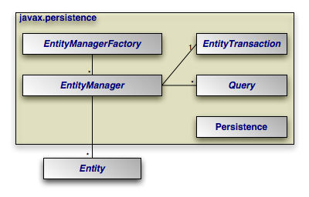


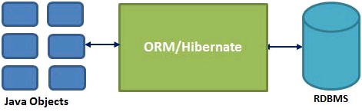
ORM, Hibernate and JPA
Concepts, Overview, History

Slide 4
What is ORM?
In relational databases, business entities are represented as tables + relationships
In object-oriented languages, business entities are represented as classes
Object relational mapping frameworks (ORMs) are used for mapping business entities to database tables
OO
Programming
Language
ORM
Framework
Relational
Database

Slide 5
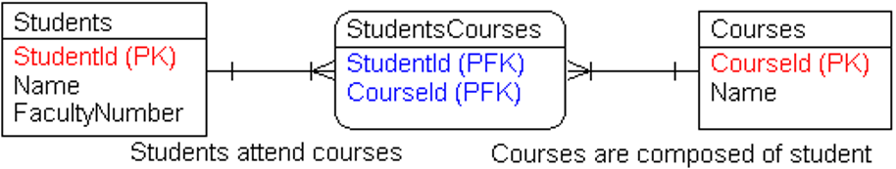
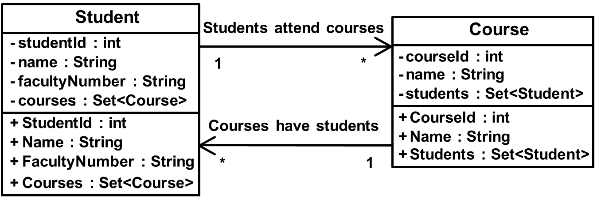
ORM – Example

Slide 6
ORM Technologies
ORM (Object-Relational Mapping) technologies
Map database tables to objects and enables CRUD operations, queries, concurrency, transactions, etc.
Dramatically simplifies the development of DB applications
ORM technologies in the Java world
Hibernate – the most popular ORM library for Java (open source)
EclipseLink – ORM for Java by Eclipse foundation (open source)
Java Persistence API (JPA) – the standard for ORM in Java

Slide 7
ORM in Java: Products and History
Hibernate ORM – http://hibernate.org/orm/
The first popular ORM framework in the Java world (2001)
Alternative to J2EE persistence technology called "EJB"
EclipseLink – https://eclipse.org/eclipselink/
ORM for Java by Eclipse foundation
Maps classes to database, XML and Web services
JDO (Java Data Objects) – http://db.apache.org/jdo/
Java ORM persistence framework (retired)

Slide 8
ORM in Java: Products and History (2)
DataNucleus (formerly JPOX) – http://datanucleus.org
Open source Java persistence framework for accessing relational databases, NoSQL databases, XML, Web service storage, LDAP, etc.
Java Persistence API (JPA)
The official standard for ORM in Java and Java EE (JSR 338)
Unifies JDO (Java Data Objects) and EJB CMP (Enterprise JavaBeans, container-managed persistence Entity Beans)
Implemented by most Java ORMs like Hibernate ORM, EclipseLink, OpenJPA, Apache JDO, Oracle TopLink, DataNucleus, …

Slide 9
Java ORM Approaches
Different approaches to Java ORM:
POJO (Plain Old Java Objects) + XML mappings
A bit old-fashioned, but very powerful
Implemented in the "classical" Hibernate
Annotated Java classes (POJO) mapped to DB tables
The modern approach, based on Java annotations
Easier to implement and maintain
Code generation
A tool generates classes based on some ORM / persistence framework

Slide 10
ORM Approaches: POJO + XML Mappings
POJO (Plain Old Java Objects) + XML mappings
public class Post {
private int id;
private String title;
private Set<Tag> tags;
public int getId() { … }
public void setId(…) { … }
public int getTitle() …
public void setTitle() …
public int getTags() …
public void setTags() …
}
<hibernate-mapping>
<class name="model.Post" table="POSTS">
<id name="id" column="POST_ID">…</id>
<property name="title" column="TITLE" />
<set name="tags" table="POST_TAGS">
<key column="POST_ID"/>
<many-to-many class="model.Tag"
column="TAG_ID"/>
</set>
…
</class>
</hibernate-mapping>

Slide 11
ORM Approaches: Annotated Java Classes
Java classes (POJO) + annotations
@Entity
public class Post {
@Id private int id;
private String title;
@OneToMany(mappedBy="posts")
private Set<Tag> tags;
public int getId() { … }
public void setId(int id) {…}
…
}
@Entity
public class Tag {
@Id private int id;
private String text;
public int getId() { … }
public void setId(int id) {…}
public int getText() { … }
public void setText(…) {…}
…
}

Slide 12
Hibernate ORM
Object-Relational Persistence for Java

Slide 13
What is Hibernate?
Hibernate is Java ORM framework
Open-source, free (LGPL license)
http://hibernate.org/orm/
Based on modern OOP methodologies
Transparently persists and retrieves POJO objects in DB tables
Stable, well established product, large developer community
Very powerful: queries, criteria API, concurrency, caching, …
Supports many databases: Oracle, MySQL, SQL Server, Derby, …

Slide 14
Downloading and Installing Hibernate ORM
Download Hibernate ORM from
http://hibernate.org/orm/
You will get the binaries, documentation and source code:
hibernate-4.3.x\lib – binaries (JAR files)
lib\required – the Hibernate JARs (include then in your classpath)
lib\jpa – the Hibernate JPA JARs (include them for JPA projects)
hibernate-4.3.x\documentation – manual, guides, API docs
hibernate-4.3.x\project – source code, unit tests, examples

Slide 15
Configuring Hibernate
The hibernate.cfg.xml holds the Hibernate configuration:
Database connection settings
JDBC driver class
JDBC URL, username and password
SQL dialect settings
Hibernate XML mappings references
Other settings

Slide 16
Sample hibernate.cfg.xml
<?xml version='1.0' encoding='utf-8'?>
<!DOCTYPE …>
<hibernate-configuration>
<session-factory>
<!-- Database connection settings -->
<property name="connection.driver_class">oracle.jdbc.driver.OracleDriver</property>
<property name="connection.url">jdbc:oracle:thin:@localhost:1521/xe</property>
<property name="connection.username">university</property>
<property name="connection.password">secret!</property>
<!-- SQL dialect -->
<property name="dialect">org.hibernate.dialect.OracleDialect</property>
<!-- Hibernate mappings references -->
<mapping resource="Person.hbm.xml"/>
<mapping resource="Student.hbm.xml"/>
…
</session-factory>
</hibernate-configuration>

Slide 17
Configuring Logging with Log4J
Include log4j-1.2.17.jar in your project classpath
The Log4j configuration file log4j.properties
# …
log4j.rootLogger=WARN, stdout
log4j.logger.org.hibernate=INFO
### Log the SQL statements executed by Hibernate
log4j.logger.org.hibernate.SQL=ALL
### Log JDBC bind parameters
log4j.logger.org.hibernate.type=ALL
# …

Slide 18
University Database Schema

Slide 19
Creating the Entity Classes
Entity classes are just POJO (Plain Old Java Objects)
package model;
public class Department {
private long deptId;
private String name;
private Set<Course> courses = new HashSet<Course>();
…
}
public class Course { … }
public class Person { … }
public class Student extends Person { … }
public class Professor extends Person { … }

Slide 20
Mapping the Entity Classes to DB Tables
Department.hbm.xml
<hibernate-mapping>
<class name="model.Department" table="DEPARTMENTS">
<id name="deptId" column="DEPTID">
<generator class="identity" />
</id>
<property name="name" column="DEPTNAME" />
<set name="courses" table="COURSES">
<key column="DEPTID" />
<one-to-many class="model.Course" />
</set>
</class>
</hibernate-mapping>

Slide 21
Opening a Hibernate Session
Configuration cfg = new Configuration();
cfg.configure();
ServiceRegistry serviceRegistry =
new StandardServiceRegistryBuilder().applySettings(
cfg.getProperties()).build();
SessionFactory factory =
cfg.buildSessionFactory(serviceRegistry);
Session session = sessionFactory.openSession();
// Perform quieries and CRUD operations here
session.close();

Slide 22
Listing Entities from Database
…
Session session = sessionFactory.openSession();
Criteria allStudentsCriteria =
session.createCriteria(Department.class);
List<Department> allDepartments =
allStudentsCriteria.list();
for (Department dept : allDepartments) {
System.out.println(
dept.getDeptId() + " " + dept.getName());
}
session.close();

Slide 23
Executing Queries with Parameters
…
Session session = sessionFactory.openSession();
Query studentsQuery = session.createQuery(
"from Student s where facultyNumber LIKE :fn");
studentsQuery.setParameter("fn", "%12%");
List<Student> students = studentsQuery.list();
for (Student stud : students) {
System.out.println(stud.getFirstName() + " " +
stud.getLastName() + " " + stud.getFacultyNumber());
}
session.close();

Slide 24
CRUD Operations: Insert Entity
try {
session.beginTransaction();
Student student = new Student();
student.setFirstName("Ivan");
student.setLastName("Ivanov");
student.setFacultyNumber("123");
session.save(student);
session.getTransaction().commit();
} catch (RuntimeException e) {
session.getTransaction().rollback();
throw e;
}

Slide 25
CRUD Operations: Update Entity
try {
session.beginTransaction();
Student student = (Student) session.get(Student.class, 17L);
student.setFirstName(student.getFirstName() + "2");
session.save(student);
session.getTransaction().commit();
} catch (RuntimeException e) {
session.getTransaction().rollback();
throw e;
}

Slide 26
Hibernate ORM
Live Demo

Slide 27
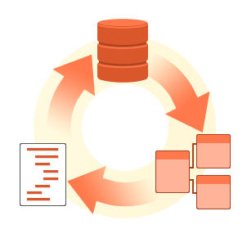
Java Persistence API (JPA)
Mapping Entities, Queries, CRUD Operations

Slide 28
About JPA
What is Java Persistence API (JPA)?
Database persistence technology for Java (official standard)
Object-relational mapping (ORM) technology
Operates with POJO entities with annotations or XML mappings
Implemented by many ORM engines: Hibernate, EclipseLink, …
JPA maps Java classes to database tables
Maps relationships between tables as associations between classes
Provides CRUD functionality and queries
Create, read, update, delete + queries

Slide 29
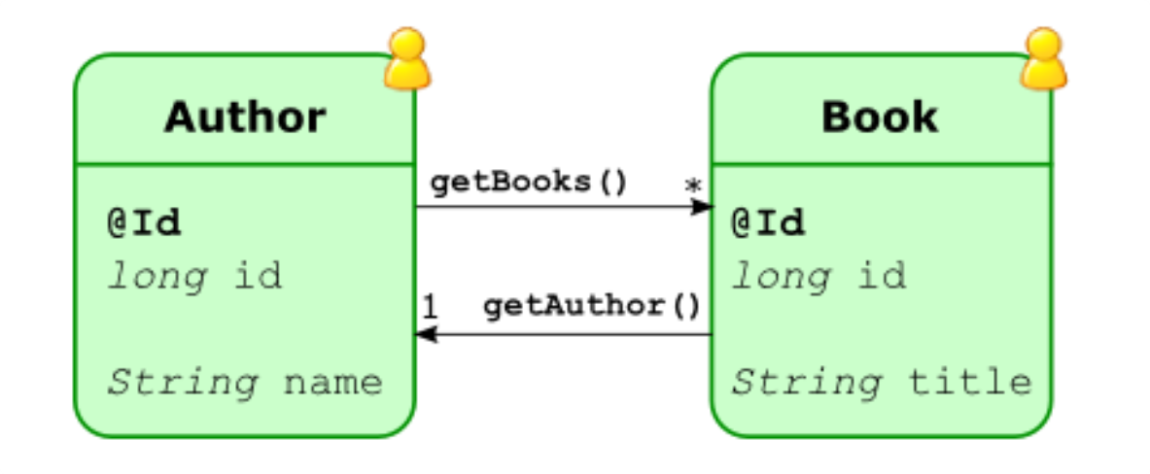
JPA Entities
Defining Simple Entity Classes

Slide 30
Entities in JPA
A JPA entity is just a POJO class
Abstract or concrete top level Java class
Non-final fields/properties, no-arguments constructor
No required interfaces
No requirement for business or callback interfaces
Direct field or property-based access
Getter/setter can contain logic (e.g. validation)

Slide 31
The Minimal JPA Entity: Class Definition
Must be indicated as an Entity
@Entity annotation on the class:
Entity entry in XML mapping file
@Entity
public class Employee { … }
<entity class="model.Employee" />

Slide 32
The Minimal JPA Entity: Primary Key
Must have a persistent identifier (primary key):
@Entity
public class Employee {
@Id int id;
public int getId() {
return id;
}
public void setId(int id) {
this.id = id;
}
}

Slide 33
Primary Key (Id) Definitions
Simple id – single field/property
Compound id – multiple fields
Embedded id – single field of PK class type
@Id int id;
@Id String firstName;
@Id String lastName;
@EmbeddedId EmployeePK id;

Slide 34
Primary Key Identifier Generation
Identifiers can be generated in the database
@GeneratedValue on the ID field
Several pre-defined generation strategies:
IDENTITY, SEQUENCE, TABLE, AUTO
May pre-exist or be generated
AUTO strategy indicates that the provider will choose a strategy
@Id @GeneratedValue int id;

Slide 35
Using Identity or Sequence
Using identity (auto increment column in the database) for Id generation:
Using database sequence for Id generation:
@Id @GeneratedValue(strategy=GenerationType.IDENTITY) private int id;
@Id @GeneratedValue(generator="UsersSeq") @SequenceGenerator(name="UsersSeq",sequenceName="USERS_SEQ")
private long id;

Slide 36
Simple Column Mappings
Mapping a class field to a database column:
A column name can be explicitly given:
@Entity public class Message {
private String message;
public void setMessage(String msg) { message = msg; }
public String getMessage() { return message; }
}
@Column(name="SAL")
private double salary;

Slide 37
Persistence Contexts and EntityManager
Manipulating Database Entities

Slide 38
Persistence Context (PC)
The persistence context (PC)
Holds a set of “managed” entity instances
Keyed by persistent identity (primary key)
Only one entity with a given persistent ID may exist in the PC
Added to the PC, but not individually removable (“detached”)
Managed by EntityManager
The PC change as a result of operations on EntityManager API

Slide 39
Persistence Context (PC) and Entities
Persistence Context
Application
EntityManager
MyEntity A
MyEntity C
MyEntity a
MyEntity B
MyEntity b
Entities
Entity state

Slide 40
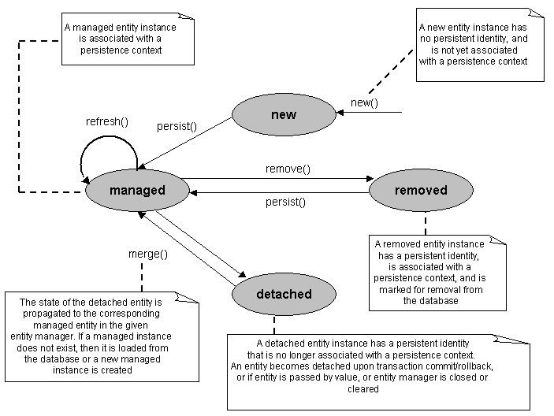
JPA Entities Lifecycle

Slide 41
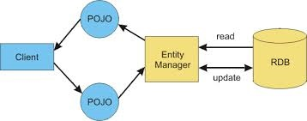
The Entity Manager
Client-visible object for operating on entities
API for all the basic persistence operations (CRUD)
Manages connection and transaction
Can think of it as a proxy to a persistence context

Slide 42
Operations on Entities
EntityManager API
persist() – persists given entity object into the DB (SQL INSERT)
remove() – deletes given entity into the DB (SQL DELETE by PK)
refresh() – reloads given entity from the DB (SQL SELECT by PK)
merge() – synchronize the state of detached entity with the PC
find() – execute a simple query by PK
createQuery() – creates a query instance using dynamic JPQL

Slide 43
Operations on Entities (2)
createNamedQuery()
Creates an instance for a predefined JPQL query
createNativeQuery()
Creates an instance for an SQL query
contains()
Determine if given entity is managed by the PC
flush()
Forces changes in the PC to be saved in the database (automatically called on transaction commit)

Slide 44
EntityManager.persist()
Insert a new entity instance into the database (SQL INSERT / UPDATE)
Save the persistent state of the entity and any owned relationship references
Entity instance becomes managed
public Customer createCustomer(int id, String name) {
Customer cust = new Customer(id, name);
entityManager.persist(cust);
return cust;
}

Slide 45
find() and remove()
find()
Obtain a managed entity instance (SQL SELECT by PK)
Return null if not found
remove()
Delete a managed entity by PK
public void removeCustomer(Long custId) {
Customer cust = entityManager.find(Customer.class, custId);
entityManager.remove(cust);
}

Slide 46
merge()
Merges the state of detached entity into a managed copy of the detached entity
Returned entity has a different Java identity than the detached entity
May invoke SQL SELECT
public Customer storeUpdatedCustomer(Customer cust) {
return entityManager.merge(cust);
}

Slide 47



JPA Queries
Using JPQL

Slide 48
JPA Queries
JPA supports powerful querying API
Dynamic or statically defined (named queries)
Criteria using JPQL (Java Persistence API Query Language)
SQL-like language
Native SQL support (when required)
Named parameters bound at execution time (no SQL injection)
Pagination and ability to restrict size of result
Single/multiple-entity results, data projections
Bulk update and delete operations on an entity

Slide 49
JPA Query API
Query instances are obtained from factory methods on EntityManager, e.g.
JPA query API:
getResultList() – execute query returning multiple results
getSingleResult() – execute query returning single result
executeUpdate() – execute bulk update or delete
Query query = entityManager.createQuery(
"SELECT e from Employee e");

Slide 50
JPA Query API (2)
setFirstResult() – set the first result to retrieve (start)
setMaxResults() – set the maximum number of results to retrieve
setParameter() – bind a value to a named or positional parameter
setHint() – apply a vendor-specific hint to the query
setFlushMode() – apply a flush mode to the query when it gets run

Slide 51
Dynamic Queries – Example
Use createQuery() factory method at runtime
Pass in the JPQL query string
Get results by getResultList() / getSingleResult()
public List findAll(String entityName){
return entityManager.createQuery(
"select e from " + entityName + " e")
.setMaxResults(100)
.getResultList();
}

Slide 52
Named Queries
Named queries are once defined and invoked later many times
@NamedQuery(name="Sale.findByCustId", query="select s from Sale s where s.customer.id = :custId order by s.salesDate")
public List findSalesByCustomer(Customer cust) {
return (List<Customer>)entityManager.
createNamedQuery("Sale.findByCustId")
.setParameter("custId", cust.getId())
.getResultList();
}

Slide 53
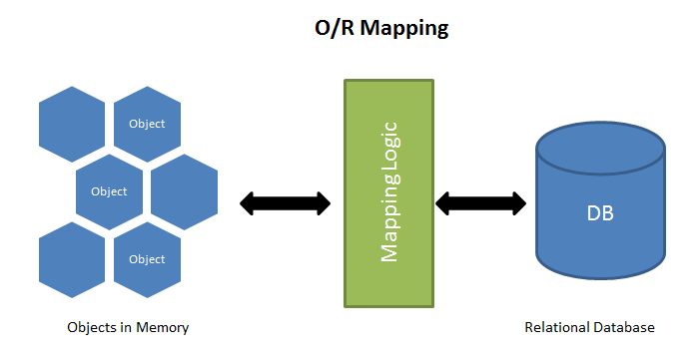
ORM Mappings
Mapping Tables to Classes by Annotations or XML

Slide 54
Object / Relational Mapping
Map persistent object state to relational database
Map relationships between entities
Metadata may be described as annotations or XML (or both)
Annotations
Describe the logical (object) model, e.g. @OneToMany
Describe the physical model (DB tables and columns), e.g. @Table
XML mappings
Can specify scoped settings or defaults

Slide 55
Simple Mappings
Direct mappings of fields to columns
@Basic – optional, indicates simple mapped attribute
Can specify fetch=EAGER / fetch=LAZY
Maps any of the common simple Java types
Primitives (int, long, String), wrappers, serializable, etc.
Used in conjunction with @Column
Can override any of the defaults

Slide 56
Fetching and Cascading Retrieval
State may be “fetched” as EAGER or LAZY
LAZY – container defers loading until the field or property is accessed (load on demand)
EAGER – requires that the field or relationship be loaded when the referencing entity is loaded (pre-load)
Cascading of entity operations to related entities
Fetch mode may be defined per relationship
Configurable globally in the mapping files

Slide 57

Simple Mappings (Annotations)
public class Customer {
int id;
String name;
int creditRating;
Image photo;
}
@Entity
CUSTOMER
@Id
PHOTO
ID
NAME
CREDIT
@Column(name="CREDIT")
@Lob

Slide 58
Simple Mappings (XML)
<entity class="model.Customer">
<attributes>
<id name="id" />
<basic name="name" /> <basic name="creditRating"> <column name="CREDIT" /> </basic>
<basic name="photo"><lob /></basic>
</attributes>
</entity>

Slide 59
Relationship Mappings
Common relationship mappings supported
@ManyToOne, @OneToOne – single entity
@OneToMany, @ManyToMany – collection
Unidirectional or bidirectional
Owning and inverse sides
Owning side specifies the physical mapping
@JoinColumn to specify foreign key DB column
@JoinTable decouples physical relationship mappings from entity tables

Slide 60
Many-To-One Mapping (Annotations)
public class Sale {
int id;
...
Customer cust;
}
@Entity
SALE
@Id
ID
…
CUST_ID
@ManyToOne
@JoinColumn(name="CUST_ID")
CUSTOMER
ID
…

Slide 61
Many-To-One Mapping (XML)
<entity class="model.Sale">
<attributes>
<id name="id" />
…
<many-to-one name="cust">
<join-column name="CUST_ID" />
</many-to-one>
</attributes>
</entity>

Slide 62
One-To-Many Mapping (Attributes)
public class Customer {
int id;
Set<Sale> sales;
}
@Entity
CUSTOMER
@Id
ID
…
@OneToMany(mappedBy="cust")
public class Sale {
int id;
Customer cust;
}
SALE
@Entity
ID
…
CUST_ID
@Id
@ManyToOne

Slide 63
One-To-Many Mapping (XML)
<entity class="model.Customer">
<attributes>
<id name="id" />
…
<one-to-many name="sales" mapped-by="cust"/>
</attributes>
</entity>

Slide 64

Using the Persistence API
Creating Standalone JPA Applications

Slide 65
Persistence in Java SE
No deployment phase
Application must use a “Bootstrap API” to obtain an EntityManagerFactory
Resource-local EntityManagers
Application uses a local EntityTransaction obtained from the EntityManager

Slide 66
Entity Transactions
Only used by resource-local EntityManagers
Transaction demarcation under explicit application control using EntityTransaction API
begin(), commit(), rollback(), isActive()
Underlying (JDBC) resources allocated by EntityManager as required

Slide 67
Persistence Class
javax.persistence.Persistence
Root class for bootstrapping an EntityManager
Locates provider service for a named persistence unit
Invokes on the provider to obtain an EntityManagerFactory

Slide 68
EntityManagerFactory Class
javax.persistence.EntityManagerFactory
Obtained by the Persistance
Creates EntityManager for a named persistence unit or configuration
In Java SE environment the persistence unit configuration is defined in the META-INF/persistence.xml file

Slide 69
Sample Config: META-INF/persistence.xml
<?xml version="1.0" encoding="UTF-8"?>
<persistence xmlns="http://java.sun.com/xml/ns/persistence"
xmlns:xsi="http://www.w3.org/2001/XMLSchema-instance" version="1.0">
<persistence-unit name="hellojpa">
<class>model.Message</class>
<properties>
<property name="ConnectionURL"
value="jdbc:derby:messages-db;create=true"/>
<property name="ConnectionDriverName"
value="org.apache.derby.jdbc.EmbeddedDriver"/>
<property name="ConnectionUserName" value=""/>
<property name="ConnectionPassword" value=""/>
</properties>
</persistence-unit>
</persistence>

Slide 70
JPA Bootstrap – Example
public class PersistenceExample {
public static void main(String[] args) {
EntityManagerFactory emf =
Persistence.createEntityManagerFactory("SomePUnit");
EntityManager em = emf.createEntityManager();
em.getTransaction().begin();
// Perform finds, execute queries, update entities, etc.
em.getTransaction().commit();
em.close();
emf.close();
}
}

Slide 71
Java Persistence API (JPA)
Live Demo

Slide 72







ORM in Java: Hibernate and JPA
https://softuni.bg/courses/database-applications

Slide 73
License
This course (slides, examples, demos, videos, homework, etc.) is licensed under the "Creative Commons Attribution-NonCommercial-ShareAlike 4.0 International" license
Attribution: this work may contain portions from
"Databases" course by Telerik Academy under CC-BY-NC-SA license

Slide 74





Free Trainings @ Software University
Software University Foundation – softuni.org
Software University – High-Quality Education, Profession and Job for Software Developers
softuni.bg
Software University @ Facebook
facebook.com/SoftwareUniversity
Software University @ YouTube
youtube.com/SoftwareUniversity
Software University Forums – forum.softuni.bg

